Slide 2
Supporting and developing your child’s talking
Randal Cremer Primary School
Laura Randall
Speech and Language Therapist

Slide 3
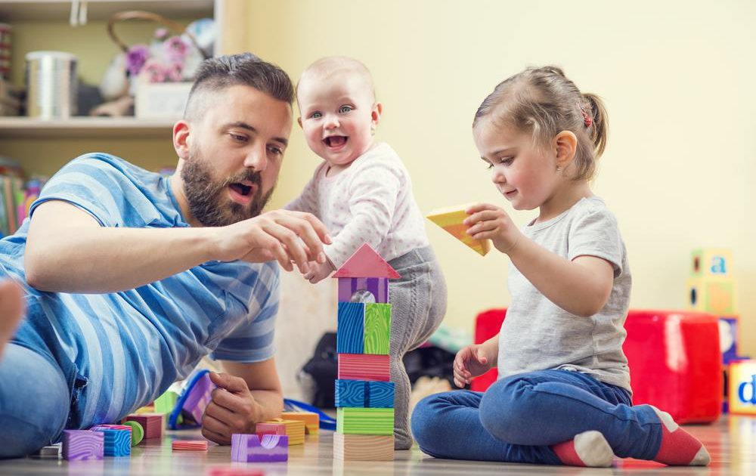
What are we going to do today?
Learn what we are doing at school to support children’s language development
Learn how to support your child’s language development at home
Stay and play!

Slide 4
What is Launchpad for Language?
An early years language development programme
It is tailored to meet the needs of Nursery and Reception classes at Randal Cremer Primary school.
Half a day a week specialist time to support with developing communication friendly environments.
To work with parents and staff to support children’s language skills.
A range of fun activities is available to put in place each term.

Slide 5
What is Launchpad for Language?
Working with the children directly – run whole class sessions and small language groups
Training to teaching staff
Developing the communication environment
Liaising with parents

Slide 6
What we are doing in school this half term-
Alan the Alien Learns to Listen
Alan the Alien Learns to Listen! The classroom’s newest and strangest member, Alan the Alien, is embarking on a journey to learn how to listen in class. The children are helping him by playing fun listening games and showing him how to be a good listener.

Slide 7
Parent Child Interaction ‘Stay and Play’
Aim: To help parents support their children’s language development at home.
Do this through play and interaction strategies that promote language learning and use.

Slide 8
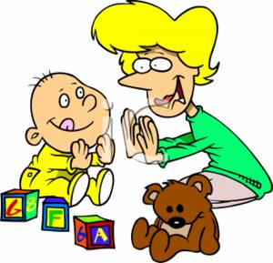
Playing together at home is key in supporting language and learning
Play and interaction with others is the main way our children develop language, increase their vocabularies and can therefore develop friendships, maintain relationships and learn

Slide 9
Something to try at home…
Special Times lasts for five minutes only and should not be extended.
Before you start, let your child choose a game. We do not want this to be a computer game, book, physical game or watching TV. It should be a game where you can interact with your child, for example, playing with toy cars or dolls, building with bricks or playing with a puzzle.
When your child has decided on a game, go somewhere quiet without obvious distractions.
Play with your child for five minutes, giving them your undivided attention.
Afterwards, you can continue the activity with your child, but this is no longer a part of Special Time.

Slide 10
Today’s targets:
Follow your child’s lead in play
Comment on what your child is doing using key words (Less Questions)

Slide 11
Thinking about our interaction

Slide 13
Remember when you get home:
Have a special time every day
Play fun listening games
Help develop vocabulary- Collect interesting items at home & outside with Alan the Alien. Talk to your child about the items
Notes:
Play dough analogy

Slide 14
Laura.randall@learningtrust.co.uk
Find us online:
Web: http://gethackneytalking.co.uk/
Twitter: @HackneyTalk
Facebook: https://www.facebook.com/gethackneytalking/
Please talk to your class teacher if you have any concerns about your child’s Speech, Language & Communication

